Slide 1

MENTAL HEALTH IN TECH INDUSTRY
An Exploratory Data Analysis
Rohit Singhal

Slide 2


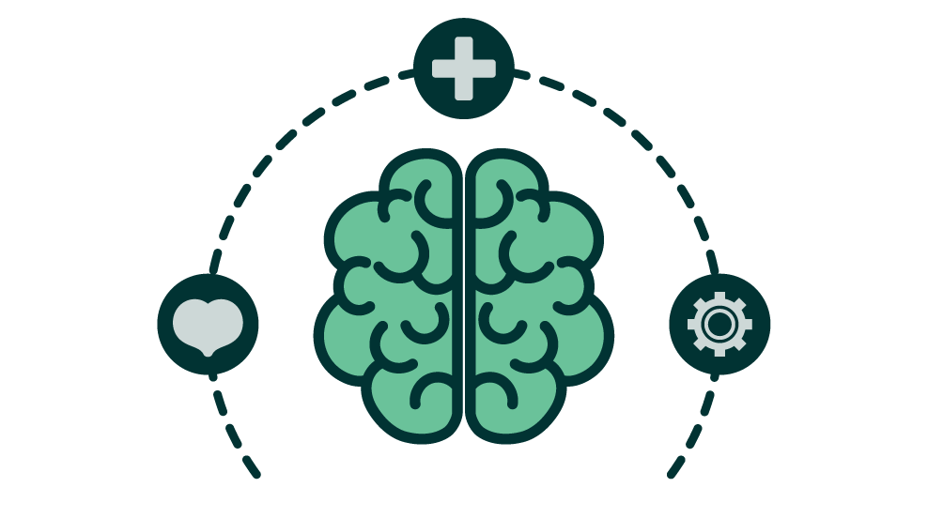



Research Questions
Data Source:
OSMI 2019 Mental Health in Tech Survey
https://www.kaggle.com/datasets/osmihelp/osmi-mental-health-in-tech-survey-2019
1. SUPPORT IN TECH
Do employees feel that the tech industry supports mental health and wellbeing?
5. LEAVE POLICY
2. EXPERIENCING ISSUES
Are the leave policies favourable to those undergoing mental health issues?
How many respondents have experienced mental health problems or are currently being diagnosed?
4. MENTAL VS. PHYSICAL HEALTH
3. HEALTHCARE & HELP
Do employers give the same amount of importance to mental health and physical health issues?
What are healthcare benefits, awareness initiatives and help resources available to employees at workplaces?

Slide 3
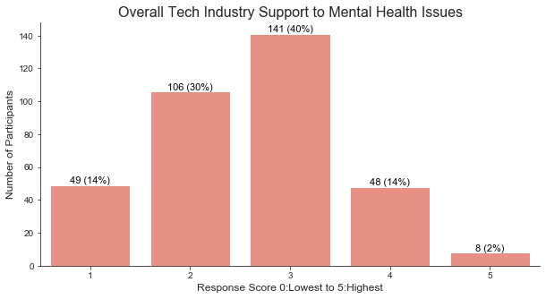
Support for Mental Health in Tech
84% of the participants have responded with a score between 1 to 3 to indicate inadequate support
40% participants have voted for score 3 indicating moderate support
Only 16% of the participants have responded with a score between 4 and 5 to indicate good support
Implications
Overall perception of support for mental health in tech is not adequate

Slide 4
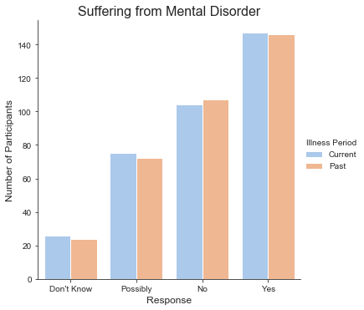
Mental Health Issues Experienced
~42% respondents (~147 / 352) have experienced a mental disorder in the past/at present
~30% participants (~107 / 352) have never experienced any mental illness
~21% participants (~75 / 352) are unsure if they have ever suffered from a mental disorder
Implications
More participation from employees who have faced a mental health issue or are not too sure could lead to potential bias in data
Since only 30% of the total participants can confidently say that they are/have not experienced mental health issues, the concern about growing mental health issues in tech industry is validated.

Slide 5
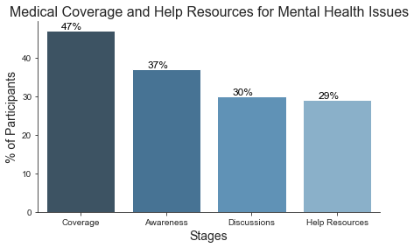
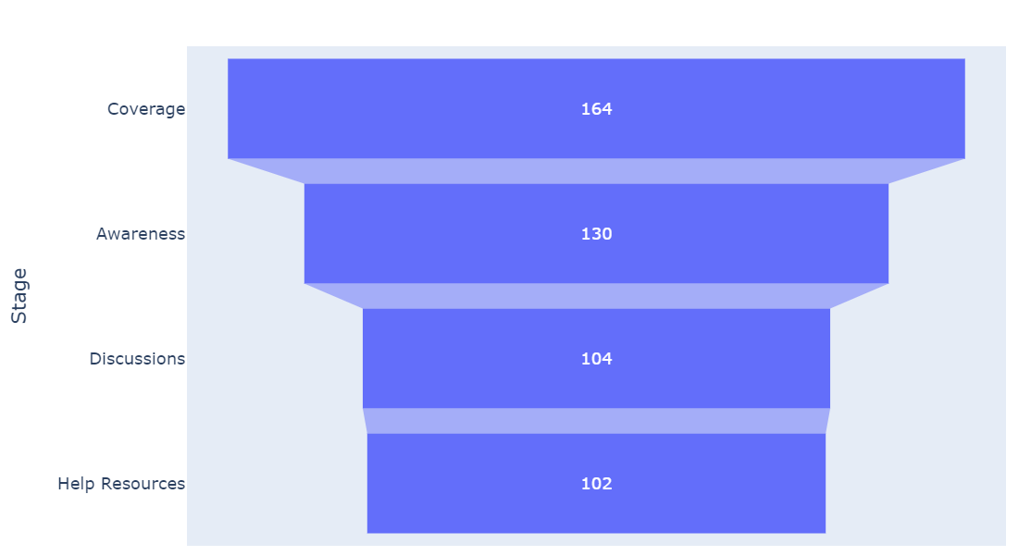
Medical Healthcare & Help Resources
The number of participants goes on decreasing as we move down the stages from coverage (47%), awareness (37%), discussions (30%) and help resources (29%).
Less than 50% of the participants have healthcare coverage for mental health issues and merely 30% end up getting additional help and resources
Implications
This suggests that the medical coverage for mental health disorders, awareness of the benefits, discussions about such issues and resources for additional help are quite limited in the tech workplaces and have room for improvement.
Mental health benefits are part of healthcare plan
Employee knows options under health coverage
Formal discussions, wellness campaigns
Resources to learn more and seek help

Slide 6
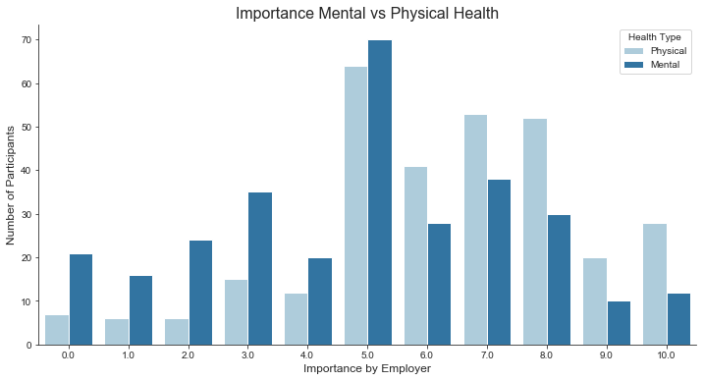
Importance for Physical & Mental Health
Importance given by employers to physical health has higher distribution between scores 5 to 10 with the peak at 5
Importance given by employers to mental health has higher distribution between scores 3 to 7 with the peak at 5
Implications
This suggests that the perception is that employers give more importance to physical health compared to mental health and should focus on moving the scores for mental health importance towards the right.

Slide 7
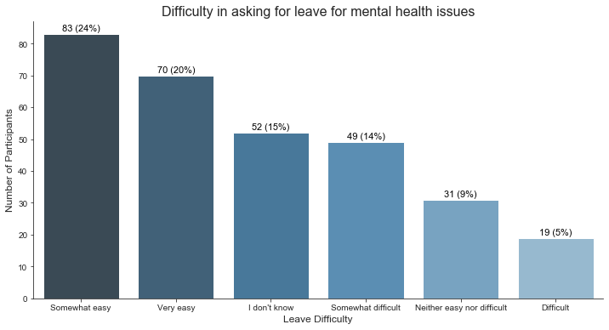
Leave Policy for Mental Health Issues
44% respondents find it relatively easy to ask for leaves for mental health while 19% respondents find it relatively difficult
24% respondents are neutral/unaware of the difficulty they may pose while asking for time off.
Implications
This suggests that the leave policies around mental health issues may be in favor of the employees at many workplaces. Employers should take more effort to improve these and create awareness among employees to shift the needle from neutral/negative responses to positive ones.

Slide 8

Conclusion
84% - inadequate support to mental health in tech
60% - may have experienced mental disorders
50% or more- don’t have medical coverage for mental issues
70% - don’t have forums to discuss and seek help
Majority - Physical Health importance then Mental Health
The leave policies seem to be in favor of employees, but employers may to take more efforts to make employees aware and comfortable of seeking time off for mental wellbeing
Limitations
Findings and Insights of this research are limited to the participants who responded to the survey and may not be a generalization of the entire tech industry and workplaces.
A study of this kind should be conducted at all workplaces to assess how employees feel about mental health.

Slide 9
Thank you!
Feedback / Questions?

